Slide 1
Team Ja-va-va-voom
Angelsberg, Rachel
Blodgett, Kirjsten
Collantes, Christine
Fang, Fan
Valdovinos, Cynthia

Slide 2
Our Project
Chosen Topic: Climate Change
Project: An interactive game dealing with different daily life choices
Each choice correlates to a score to help determine the user’s “greenness”
Choice Categories: Water, Transportation, Recycling, Energy
Target Audience: College Students
Why Use It:
It educates the user about how their daily actions affect the environment

Slide 3
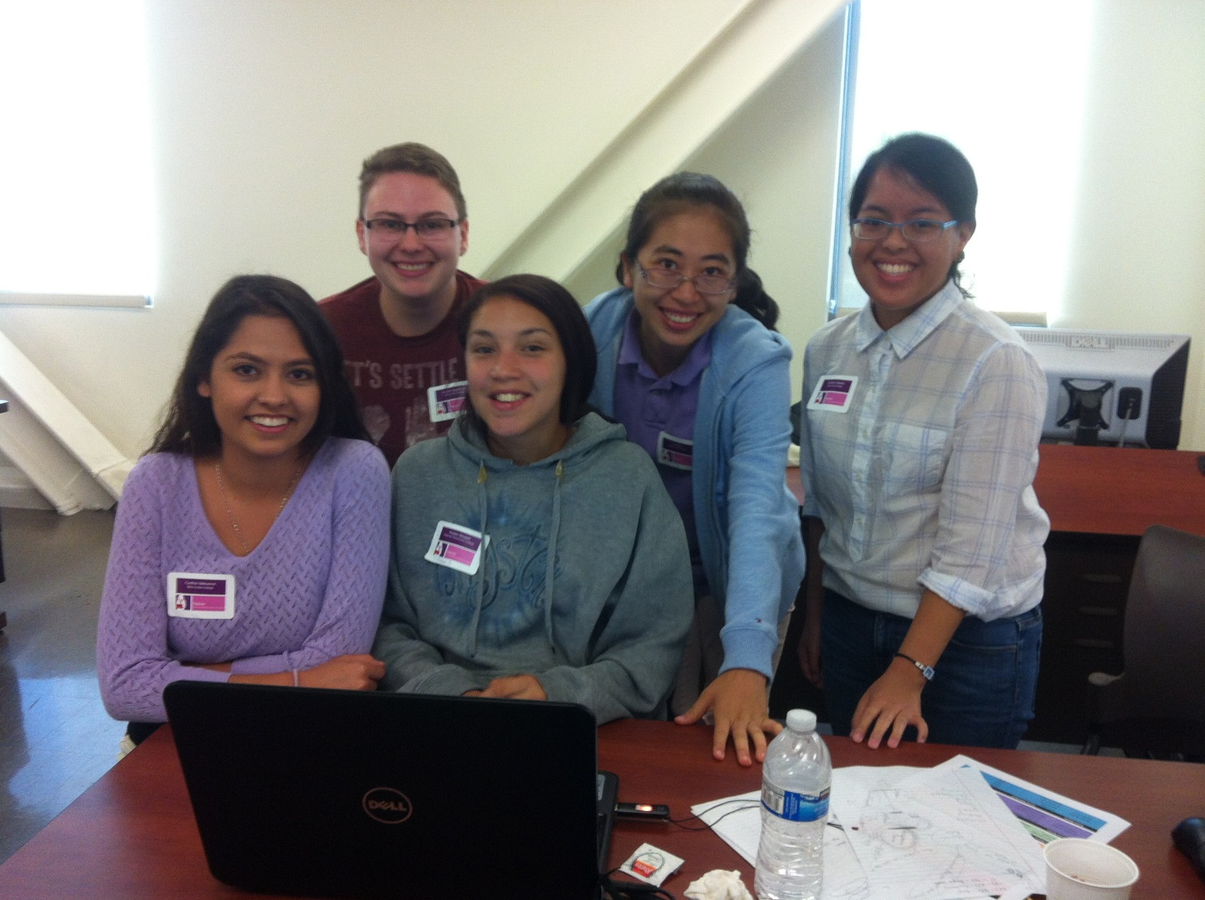
Demo Time!!!

